Slide 1

Chronic Kidney Disease Diagnosis
Dr. Sorina Dumitrescu
Department of Electrical and Computer Engineering
Prepared by:
Neelanjan Goswami
M.Eng. Electrical and Computer, McMaster University
400414867

Slide 2
Outline
Introduction
Machine Learning Algorithms
Development Of the Model
Research Methodology
Optimization Strategy
Feature Selection
Conclusion
References

Slide 3
INTRODUCTION

Slide 4
Introduction
Kidney illnesses manifest themselves in a variety of ways all around the world. Chronic Kidney Disease (CKD), has no symptoms in its early stages, thus testing may be the only method to determine whether the patient has renal disease.
Early identification of CKD in its early stages can assist patients to receive successful therapy and avoid the development of the disease into ESRD. The sooner people are aware of their illness, the sooner they may seek therapy. A cheap and fast Clinical Decision Support System (CDSS) for automatic diagnosis is particularly advantageous to battle illnesses due to the scarcity and expensive cost of professionals for manual disease diagnosis.
Artificial Neural Networks (ANN), Support Vector Machine (SVM), Naive Bayes, decision tree, extreme gradient boosting one (XGBoost), logistic regression, and fuzzy set theory, when combined with medical expertise, go a long way.

Slide 5
Introduction
The primary objectives are:
The 80:20 distinction has been used to test the evaluation process of several models.
To provide more credible results, all missing value concerns were rectified using the K-Nearest Neighbors imputation approach.
All features are prepossessed with the ability to keep their values inside the range of [0, 1] using a conventional scaler approach.
This study also looks at accuracy, error rate, execution time, AUC, and ROC statistics to demonstrate the efficacy of many classifiers.

Slide 6
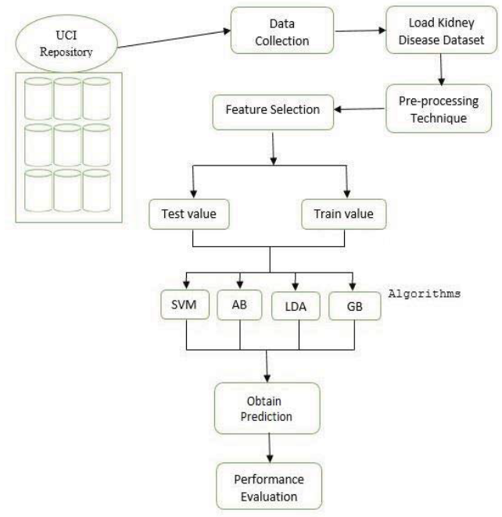
Introduction
Figure 1: The suggested kidney disease detection mechanism [3].

Slide 7
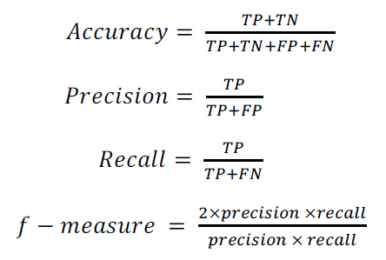
Introduction
The planned study's main goal is to develop a renal disease system that is totally based on machine learning. The goal of the study is to solve several algorithms, such as XGBoost, SVM, AB, LDA, and GB, in order to categorize persons with renal illness. This study uses various performance assessment metrics such as:

Slide 8
Machine Learning Algorithms

Slide 9
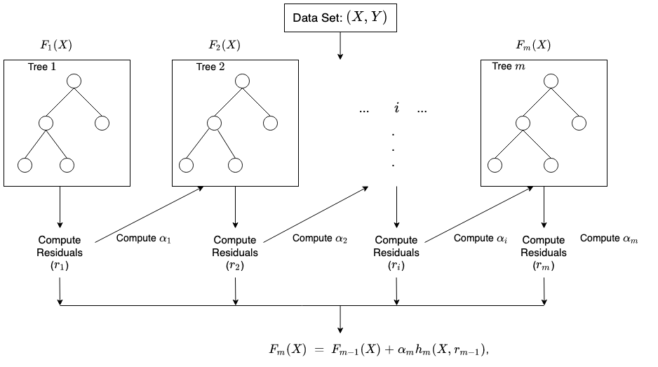
Machine Learning Algorithms
XGBoost is a distributed gradient boosting toolkit that is optimised for efficiency, flexibility, and portability. It uses the Gradient Boosting framework to create machine learning algorithms. XGBoost is a parallel tree boosting (also known as GBDT, GBM) algorithm that addresses a variety of data science issues quickly and accurately. The same algorithm may tackle problems with billions of instances in a distributed environment (Hadoop, SGE, MPI).

Slide 10
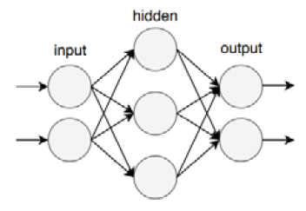
Machine Learning Algorithms
Multilayer Perceptron (MLP) is one of the most extensively used neural networks. As illustrated in figure 2, MLP is made up of three types of layers, each of which is built up of artificial neurons and connected by weighted linkages. Some neurons will be triggered to a certain value depending on the weights and a specified value termed the activation value, while others will not. The activation pattern of one layer influences the activation pattern of the following layer.
Figure 2: Basic Structure of MLP [2]

Slide 11
Machine Learning Algorithms
SVM also has been a popular choice among many academics when it comes to classification challenges since it consistently beats other classification methods. Furthermore, SVM works effectively even with a small number of samples. SVM has been utilized in a variety of applications, including optical character recognition, spam detection in email, and medical diagnostics.
Figure 3: The working process of the SVM algorithm [3]

Slide 12

Machine Learning Algorithms
The Bayesian probability theorem is the foundation of the Naive Bayes classification method. The classifier is based on the Naive Bayes assumptions, which indicate that each feature's contribution to the final result is independent and equal, suggesting that the presence/absence of one feature is unrelated to the presence/absence of another. Naive Bayes is used to compute the likelihood of an instance belonging to each target class, and the instance is deemed to belong to the target class with the highest probability using the following rule:

Slide 13
Machine Learning Algorithms
To improve classification accuracy, boosting algorithms combine various weak classifiers to generate strong classifiers. Adaptive Boosting is another useful method. LogitBoost was demonstrated to be able to overcome this problem by using stronger generalizations. Boosting algorithms are used to tackle a range of medical problems, such as detecting protein structure classes, cancer detection, and breast cancer detection. Figure 4 depicts the Adaptive Boost process:
Figure 4: The illustration process of the AdaBoost algorithm [3]

Slide 14
Machine Learning Algorithms
Gradient boosting solves the classification and regression problems. This results in a diagnostic model in the form of a collection of weak predictive analytics, commonly known as decision trees. The model is phase-wise constructed, which is consistent with existing boosting approaches, and it allows for the optimization of any differentiable loss function. The insertion of a new estimator hm(x) in equation 3 should be no problem for our approach:
Fm+1(x) = Fm(x) + hm(x) = y
Figure 5: The process of LDA algorithm and the flow of the Gradient classifier [3]

Slide 15
Development Of the Model

Slide 16
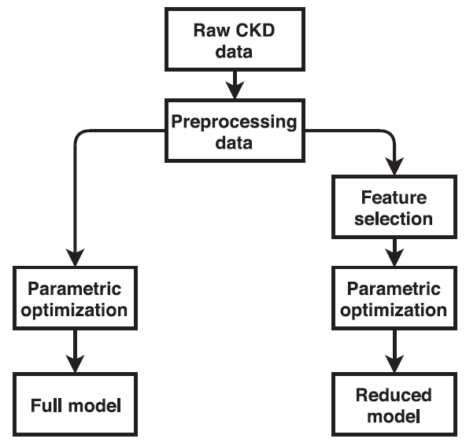
Development Of the Model
Figure 6: Methodology of model [1]

Slide 17
Development Of the Model
The dataset D = { (xi; yi), i = 1, 2, ..., N}, where xi = [ xi1 , xi2 , xi3 , ... , xip] , is a row vector whose entries are real-valued input variables (or features), and y = {0,1} (2), is a scalar whose element is the output of integer-value. The job at hand is to create a model, y = f(x), based on the training data, which is a binary classification issue.
Recursive Feature Elimination (RFE): With repeated modeling, RFE recursively decreases the features in a dataset. To fit a model, the RFE algorithm first uses all of the information. After that, the features will be rated in order of their relevance.
Extra Classifier for Trees (ETC): It was proposed by Geurts and is also known as the Extreme Randomised Classifier (ERC). ETC creates a top-down ensemble of the unpruned decision or regression trees. The technique is carried out using the feature representation and the partitioning of the nodes into right and left. A tree will continue to grow until it reaches a certain depth.

Slide 18
Development Of the Model
Predicted Class .
III Healthy .
III |  | TP | FN
Actual Class | Healthy | FP | TN
Table 1: Confusion Matrix [3]

Slide 19
Development Of the Model
Step 1: Create a validation set of 10% of the dataset and a test set of 10% of the dataset. Use the remaining 80% to create our XGBoost CKD model, which has been tuned. To check for over-fitting, the "n estimators" that define the model's epoch are set to 100 and early stopping rounds to 10.
Step 2: Find the best learning rate and gamma at the same time because they have a direct impact on the model's performance. The learning rate grid values are 0.01, 0.02, 0.03, 0.06, 0.1, 0.2, and 0.3, while the gamma grid values are 0.1, 0.2, 0.5, 1, 1.5, 2, and 10. For model tuning, all potential combinations of these two parameter values are tested, and the ones that perform best are kept as the ideal values.
Step 3: Perform a grid-search across the max depth and min child weight in specified ranges of 1 to 10 using the optimal learning rate and gamma values.
Step 4: Perform a grid-search over the L2 regularisation parameter reg lambda and subsample in specified ranges 0.1 to 1 at the same time.
Step 5: Use a grid-search value of 1 to 5 to account for imbalance in the dataset over max delta step.
Step 6: Check for discrepancies between the optimal values using a simultaneous grid search over gamma, reg lambda, and subsample.

Slide 20
Research Methodology

Slide 21
Research Methodology
The model is represented using four alternative learning strategies, as well as performance measures such as accuracy, recall, F1-score, and specificity. TP, TN, FP, and FN influence the results of performance measure indices:
True Positive (TP) = A list of instances that have been correctly classified as having CKD.
False Positive (FP) = A list of confirmed occurrences that were wrongfully labeled as having CKD.
True Negative (TN) = A list of recorded cases that have been accurately identified as having CKD.
False Negative (FN) = A list of occurrences that have been verified as having CKD.

Slide 22
Research Methodology
Name | Description | Type: unit/ values
Age (age) | Patient’s age | Numeric: years
Blood pressure (bp) | Blood pressure of the patient | Numeric: mm/Hg
Specific gravity (sg) | The ratio of the density of urine | Nominal: 1.005, 1.010, 1.015, 1.020,1.025
Albumin (al) | Albumin level in the blood | Nominal: 0,1,2,3,4,5
Sugar (su) | Sugar level of the patient | Nominal: 0,1,2,3,4,5
Red blood cells (rbc) | Patients’ red blood cells count | Nominal: normal, abnormal
Pus cell (pc) | pus cell count of patient | Nominal: normal, abnormal
Pus cell clumps (pcc) | Presence of pus cell clumps in the blood | Nominal: present, not present
Bacteria (ba) | Presence of bacteria in the blood | Nominal: present, not present
Blood glucose (bgr) | blood glucose random count | Numeric: mgs/dl
Blood urea (bu) | blood urea level of the patient | Numeric: mgs/dl
Serum creatinine (sc) | serum creatinine level in the blood | Numeric: mgs/dl
Sodium (sod) | sodium level in the blood | Numeric: mEq/L
Potassium (pot) | potassium level in the blood | Numeric: mEq/L
Hemoglobin (hemo) | hemoglobin level in the blood | Numeric: gms
Packed cell volume (pcv) | packed cell volume in the blood | Numeric
White blood cell count (wc) | white blood cell count of the patient | Numeric: cells/cumm
Red blood cell count (rc) | red blood cell count of the patient | Numeric millions/cmm
Hypertension (htn) | Does the patient has hypertension on not | Nominal: yes, no
Diabetes mellitus (dm) | Does the patient has diabetes or not | Nominal: yes, no
Coronary artery disease (cad) | Does the patient has coronary artery disease or not | Nominal: yes, no
Appetite (appet) | Patient’s appetite | Nominal: good, poor
Pedal Edema (pe) | Does patient has pedal edema or not | Nominal: yes, no
Anemia (ane) | Does patient has anemia or not | Nominal: yes, no
Class | Does the patient has kidney disease or not | Nominal: CKD, not CKD
Table 2: CKD Dataset [3]

Slide 23
Simulation of the Model

Slide 24

Simulation of the Model
A CKD dataset may be found at the University of California Irvine's (UCI) online repository. There are 400 individuals in this collection, including 250 instances of CKD and 150 cases of no CKD. The dataset is reasonably balanced in terms of the ratio of CKD-free and CKD patients.
Table 2 shows the characteristics. The patient's age (Age) ranges from 2 to 90 years. Blood pressure (BP) ranges from 50 to 120 mmHg, whereas blood glucose levels vary from 70 to 490 mg/dl (BGR).
The blood urea concentration (BU) ranges from 15 to 424 mg/dl. Outliers and incorrect data are found in four rows, which are deleted before modeling. Then there are 396 data points/rows.
The categorical characteristics in the dataset were changed to binary variables, i.e., bad or good, no or yes, not present or present were converted to zero and one.

Slide 25
Simulation of the Model
Number | Attribute | Abbreviation
1 | Age | AGE
2 | Appetite | APPET
3 | Anemia | ANE
4 | Albumin | AL
5 | Bacteria | BA
6 | Blood Pressure | BP
7 | Blood Glucose Random | BGR
8 | Blood Urea | BU
9 | Coronary Artery Disease | CAD
10 | Diabetes Mellitus | DM
11 | Pus Cell Clump | PCC
12 | Serum Creatinine | SC
13 | Sodium | SOD
14 | Potassium | POT
15 | Hemoglobin | HEMO
16 | Pack Cell Volume | PCV
17 | White Blood Cell Count | WC
18 | Red Blood Cell Count | RBCC
19 | Hypertension | HTN
20 | Pus Cell | PC
21 | Specific Gravity | SG
22 | Red Blood Cell | RBC
23 | Petal Edema | PE
24 | Sugar | SU
25 | Class | CLASS
Table 3: CKD Attributes with Abbreviations [1]

Slide 26
Simulation of the Model
Abbreviation | Accuracy | F1_score | Sensitivity | AUC | RMSE
KNN | 0.968 ± 0.032 | 0.93 ± 0.10 | 0.87 ± 0.16 | 0.98 ± 0.04 | 0.18 ± 0.18
LG | 0.981 ± 0.026 | 0.95 ± 0.10 | 0.91 ± 0.16 | 1.00 ± 0.00 | 0.14 ± 0.17
SVM | 0.981 ± 0.026 | 0.95 ± 0.10 | 0.91 ± 0.16 | 1.00 ± 0.00 | 0.14 ± 0.17
LDA | 0.981 ± 0.025 | 0.95 ± 0.10 | 0.93 ± 0.16 | 1.00 ± 0.00 | 0.14 ± 0.20
CART | 0.981 ± 0.016 | 0.96 ± 0.07 | 0.95 ± 0.10 | 0.99 ± 0.04 | 0.14 ± 0.17
XGBoost | 0.987 ± 0.016 | 0.97 ± 0.06 | 0.98 ± 0.08 | 1.00 ± 0.00 | 0.11 ± 0.16
Table 4: AI Methods' Performance [1]

Slide 27
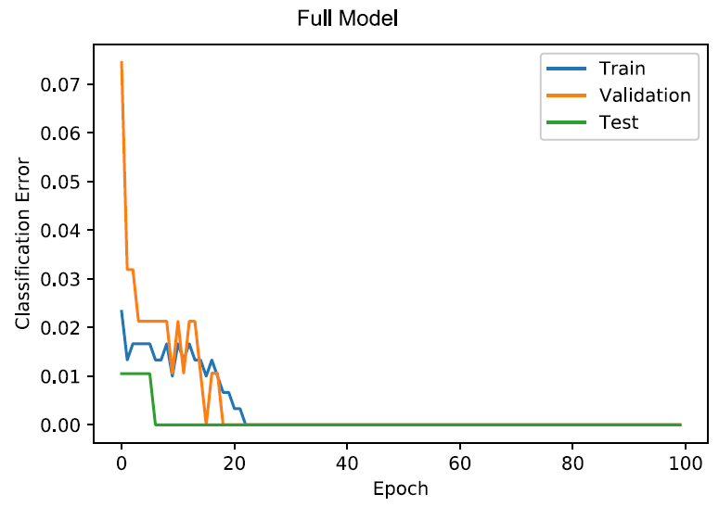
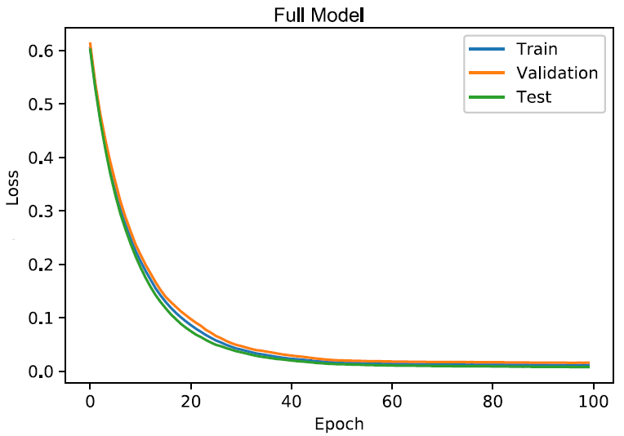
Simulation of the Model
Figure 7: Classification error of the full model [1] Figure 8: Loss function of the full model [1]

Slide 28
Simulation of the Model
Hyperparameter | Value
learning_rate | 0.1
n_estimator | 100
gamma | 0.1
reg_lambda | 0.2
subsample | 0.8
min_child_weight | 1
max_depth | 4
Table 4: Optimal Parameter Values for Full Model [1]

Slide 29
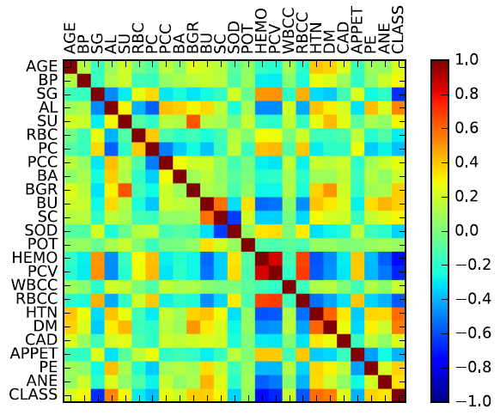
Simulation of the Model
Figure 9: Correlation plot for CKD attributes [1]

Slide 30
Simulation of the Model
Correlated characteristics are repetitive and may cause ML algorithms to perform poorly. Figure 4 depicts the relationships between the characteristics. As a result, we had to reduce the number of features. RFE, ETC, and US have cut-off thresholds of 10, 2.5, and 2.5, respectively. Following this selection, S1, S2, and S3 reflect the sets of maintained characteristics for RFE, ETC, and US, respectively. S1 has 15 features, S2 has 13, and S3 has 13 features apiece.
S1 = {DM; AL; SG; HTN; PCC; HEMO; AGE; BP; PE; PCV; SU; ANE; WBCC; RBCC; BGR}
S2 = {HEMO; DM; SG; AL; SC; PCV; APPET; WBCC; PC}
S3 = {DM; HTN; AL; ANE; PE; PCC; SG; SU; APPET; CAD; PC}

Slide 31
Optimization Strategy

Slide 32
Optimization Strategy
Classifier | Parameter | Value
ANN | Number of Layers | 1
 | Number of Neurons | 100
 | Activation Function | Linear
 | Optimization Algorithm | L-BFGS
SVM | Kernel Type | Linear
 | C | 0.001
 | Epsilon | 0.001
KNN | K | 5
 | Weight | Distance
Table 5: Optimal Parameters for Each Classifier [2]

Slide 33
Feature Selection

Slide 34
Feature Selection
Number of Attributes | Accuracy of Classifier (%) |  |  |  | Average Accuracy
 | ANN | SVM | NB | k-NN
57 (All) | 0.926 | 0.938 | 0.737 | 0.754 | 0.83875
29 | 0.934 | 0.931 | 0.762 | 0.837 | 0.866
15 | 0.656 | 0.939 | 0.774 | 0.881 | 0.8125
8 | 0.946 | 0.942 | 0.623 | 0.902 | 0.85325
4 | 0.943 | 0.946 | 0.959 | 0.910 | 0.9395
2 | 0.951 | 0.943 | 0.956 | 0.939 | 0.94725
1 | 0.943 | 0.931 | 0.935 | 0.939 | 0.937
Table 6: Result of Different Feature Subsets [2]

Slide 35
Feature Selection
Subsequently, we used the feature selection rule from sec. 2 to acquire our reduced set of the feature Sr: a feature is only chosen if it is a member of at least two of the three sets above. This gives:
Sr = {DM; AL; SG; HTN; HEMO; WBCC; AGE; PCV; ANE; PE; SU; APPET; PC}
Hyperparameter | RFE | ETC | US | Reduced
Learning_rate | 0.1 | 0.3 | 0.1 | 0.2
N_estimator | 100 | 100 | 100 | 100
gamma | 0.5 | 0.2 | 0.1 | 0.3
reg_lambda | 0.2 | 0.6 | 0.3 | 0.2
subsample | 0.5 | 0.5 | 0.8 | 0.7
min_child_weight | 2 | 1 | 2 | 2
max_depth | 3 | 3 | 2 | 3
max_delta_step | 2 | 1 | 2 | 2
Table 7: Optimal Parameter Values for the Selected Features [1]

Slide 36
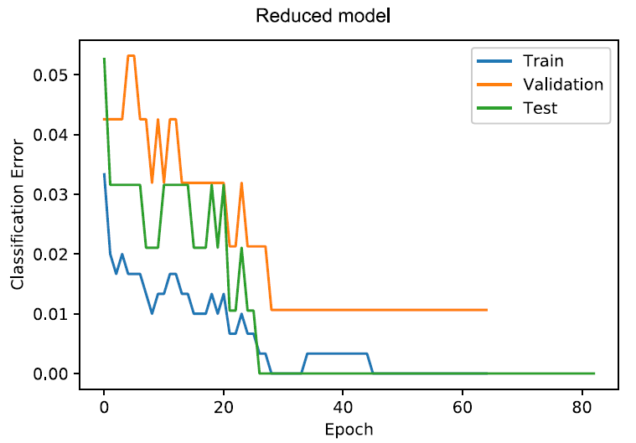
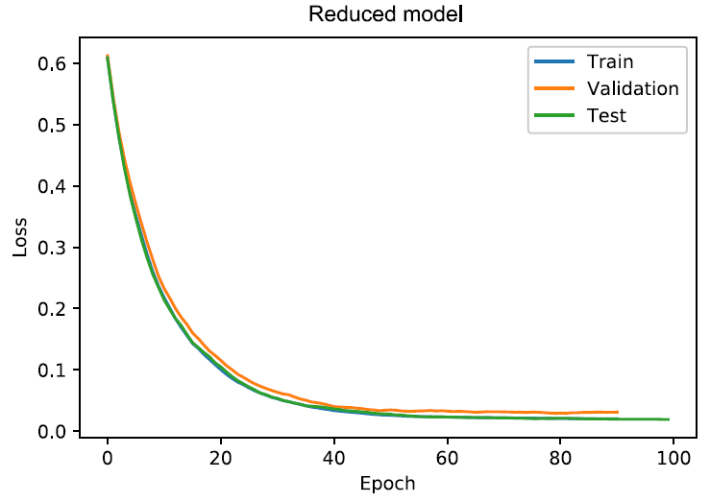
Feature Selection
Model | Accuracy | Precision | Sensitivity | Specificity | MAE
RFE | 0.989 | 0.985 | 1.000 | 0.983 | 0.011
ETC | 0.979 | 0.981 | 0.981 | 0.979 | 0.021
US | 0.979 | 1.000 | 0.969 | 0.974 | 0.021
Reduced model | 1.000 | 1.000 | 1.000 | 1.000 | 0.000
Full model | 1.000 | 1.000 | 1.000 | 1.000 | 0.000
Table 8: Model Comparison [1]
Figure 10: Classification error of reduced model [1] Figure 11: Loss function of reduced model [1]

Slide 37
Feature Selection
Figure 12: Parameters selection procedure [4]
Classifier | Accuracy | Precision | Recall | f-measure
ANN | 0.980 | 0.964 | 1 | 0.98167
SVM | 0.980 | 0.964 | 1 | 0.98167
NB | 0.980 | 0.964 | 1 | 0.98167
k-NN | 0.939 | 0.929 | 0.963 | 0.9457
Table 9: Classification Performance on Optimal Features [2]

Slide 38
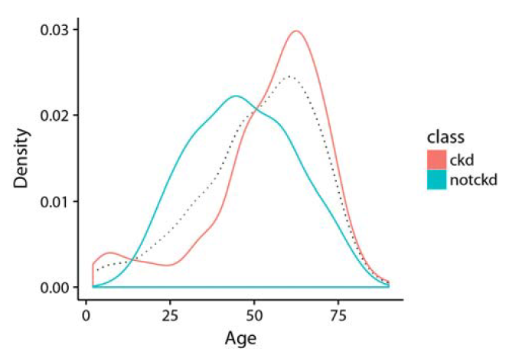
Feature Selection
Figure 13: Age distribution [4]
Predicted Class .
CKD NoCKD .
Actual Class | CKD | 11 | 0
 | NoCKD | 0 | 29
Table 10: Confusion Matrix for the Reduced Model [1]

Slide 39
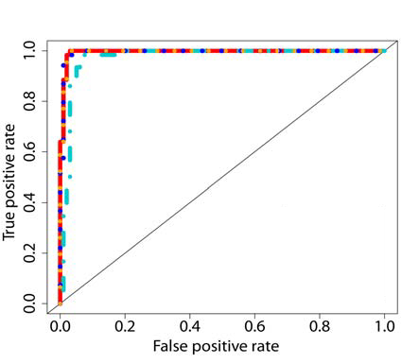
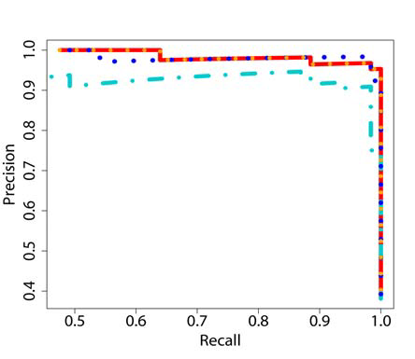
Feature Selection
Figure 14: Sensitivity, Specificity, & Accuracy [4] Figure 15: Precision, F1, & Area under ROC curve [4]

Slide 40
Conclusion

Slide 41
Conclusion
For CKD diagnosis, different machine learning algorithms were used in this work. The GB classifier, in contrast to all other techniques, produced the most beneficial results. While AB and LDA (97.91 percent) produce a low score, these models effectively yield a 99.80 percent accuracy rate.
For feature selection, the authors employed the correlation coefficient and recursive feature removal. Then, SVM, Naive Bayes, ANN, and kNN, were investigated. The classification accuracy, precision, recall, and f-measure attained by each of these classifiers were used to evaluate their performance.
ANN, SVM, and NB all had a 98 percent accuracy rate, whereas k-NN had a 93.9 percent accuracy rate., the XGBoost technique has been examined and optimized. The resultant CKD models are compared to the domain's existing CKD models. The accuracy, sensitivity, and specificity of the suggested complete model were all 1.000, 1.000, and 1.000, respectively.
By combining the strengths of each approach, three feature selection techniques are created. The accuracy, sensitivity, and specificity of a reduced model with around half of the complete features are 1.000, 1.000, and 1.000, respectively.

Slide 42
References
[1] A. Ogunleye and Q.-G. Wang, “XGBoost Model for Chronic Kidney Disease Diagnosis”, IEEE/ACM Transactions on Computational Biology and Bioinformatics, vol. 17, no. 6, Nov./Dec. 2020, pp. 2131-2140.
[2] Reem A. Alassaf, Khawla A. Alsulaim, Noura Y. Alroomi, Nouf S. Alsharif; ”Preemptive Diagnosis of Chronic Kidney Disease Using Machine Learning Techniques”, 2018, pp. 18374828, doi: 10.1109/INNOVATIONS.2018.8606040.
[3] Pronab Ghosh, F. M. Javed Mehedi Shamrat, Shahana Shultana, Saima Afrin, Atqiya Abida Anjum, Aliza Ahmed Khan, "Optimization of Prediction Method of Chronic Kidney Disease Using Machine Learning Algorithm", in IEEE Access, pp. 20492838, 2021, doi: 10.1109/iSAI-NLP51646.2020.9376787.
[4] Ahmed J. Aljaaf, Dhiya Al-Jumeily, Hussein M. Haglan, Mohamed Alloghani, Thar Baker, Abir J. Hussain, Jamila Mustafina, "Early Prediction of Chronic Kidney Disease Using Machine Learning Supported by Predictive Analytics", in IEEE Access, pp. 18133484, 2018, doi: 10.1109/CEC.2018.8477876.

Slide 43
Thank You

